Slide 1

Current and Emerging Technology Trends Among Developers: A Data Analysis of the 2019 Stack Overflow Survey
Gazali Agboola
^{July 4th, 2025}
^{https://gazmaths.github.io/}

Slide 2



OUTLINE
Executive Summary
Introduction
Methodology
Results
Visualization – Charts
Dashboard
Discussion
Findings & Implications
Conclusion
Appendix

Slide 3

EXECUTIVE SUMMARY
Most Used Languages: JavaScript leads; Python growing fast.
Most Used Languages: JavaScript and SQL lead
Web and Full-stack: Most common roles
DevOps: Gaining popularity
Data Roles: Driven by Python and R
Platforms: AWS top the list of the most platform to work with.
Databases Trends: PostgreSQL remains the most used database

Slide 4

INTRODUCTION
This presentation is based on Stack Overflow’s Developer Survey: the largest global survey of nearly 90,000 developers
Analyzes current and desired technologies used by developers
Offers demographic insights to guide hiring and training strategies
Supports data-driven decisions for tech investment and developer upskilling
Identifies global developer trends and predicts future directions

Slide 5

METHODOLOGY
Data Collection Stack
Overflow Developer Survey data extraction
GitHub Jobs API
Dataset Techniques: Web Scraping, APIs (using Python requests)
Data Preparation :
Data cleaning: Remove duplicates, handle missing values, normalize data
Wrangling: Reshape and merge datasets for analysis
Exploratory Data Analysis (EDA)
Analyze distributions, detect outliers, explore correlations
Tools: Python (Pandas, Matplotlib, Seaborn)Data
Data Visualization
Visualize distributions, relationships, and comparisons
Create interactive dashboards to highlight trends and insights
Dashboard Development
IBM Cognos Dashboard Embedded (CDE) and Google Looker Studio used for final visualization and storytelling

Slide 6
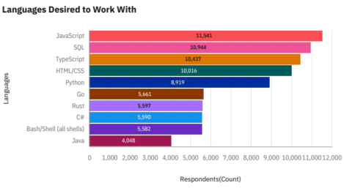
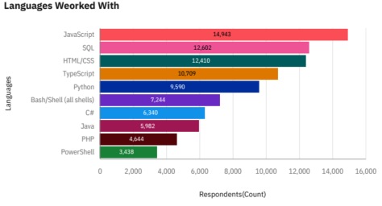
PROGRAMMING LANGUAGE TRENDS
Current Year
Next Year
Top 10 Languages Worked with
Top 10 Languages Desired to Work With

Slide 7
PROGRAMMING LANGUAGE TRENDS - FINDINGS & IMPLICATIONS
Findings
Web Technologies Dominate: JavaScript, TypeScript, HTML, and CSS continue to lead in usage.
Growth in Systems Languages: Go and Rust are gaining traction.
SQL and Python Remain Consistent: These foundational languages maintain stable interest.
Enterprise Languages Hold Steady: C# and Java continue to see reliable demand.
Decline in Legacy Technologies: PHP and PowerShell experience reduced interest.
Implications
The slight decline in interest for web technologies may reflect market saturation and maturity in the field.
Python’s sustained popularity is likely driven by its central role in AI and machine learning applications
The decline in PHP and PowerShell suggests a shift away from older, legacy systems toward modern alternatives.
PHP and PowerShell are no longer the languages of interest
Emerging languages like Rust and Go present valuable opportunities for differentiation and relevance in next-gen computing fields.

Slide 8
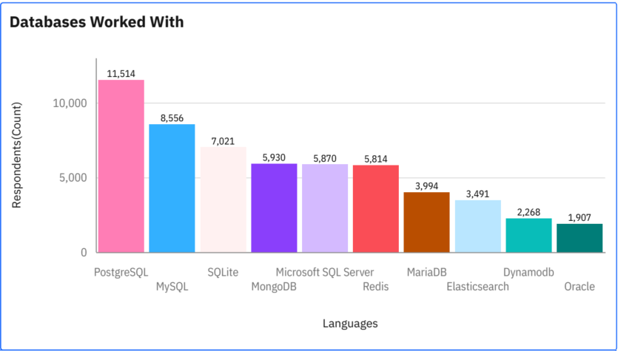
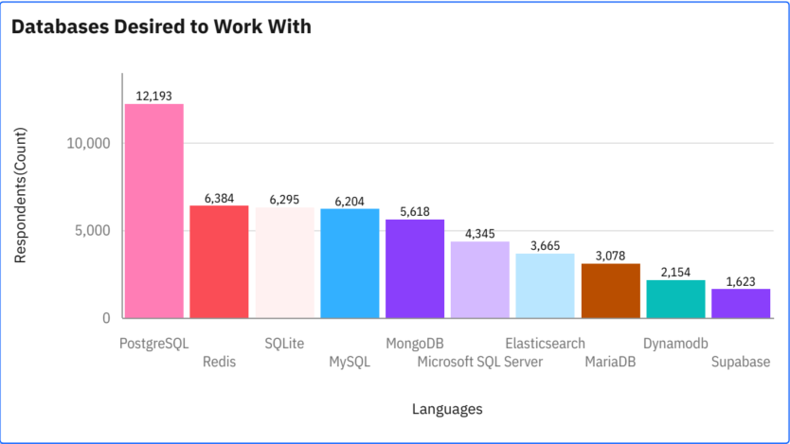
DATABASE TRENDS
Current Year
Next Year
Top 10 Databases Worked with
Top 10 Databases Desired to Work with

Slide 9
DATABASE TRENDS - FINDINGS & IMPLICATIONS
Findings
PostgreSQL stands out as the clear leader among database technologies.
Redis emerges as a fast-rising contender in the database landscape.
Interest in Oracle has declined noticeably
Implications
The strong preference for PostgreSQL suggests that organizations value its scalability, open-source nature, and extensibility.
The rise of Redis may reflect the growing demand for real-time data processing in modern applications.
The decline in Oracle's popularity indicates a broader industry shift away from traditional proprietary systems toward more flexible and cost-effective solutions.

Slide 10

DASHBOARD
Dashboard Presentation

Slide 11
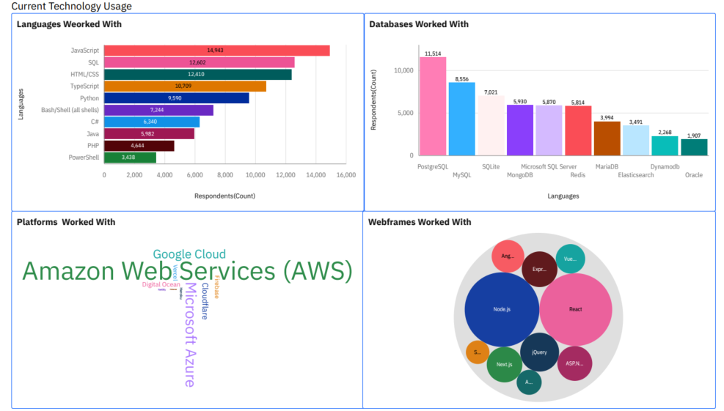
DASHBOARD TAB 1

Slide 12
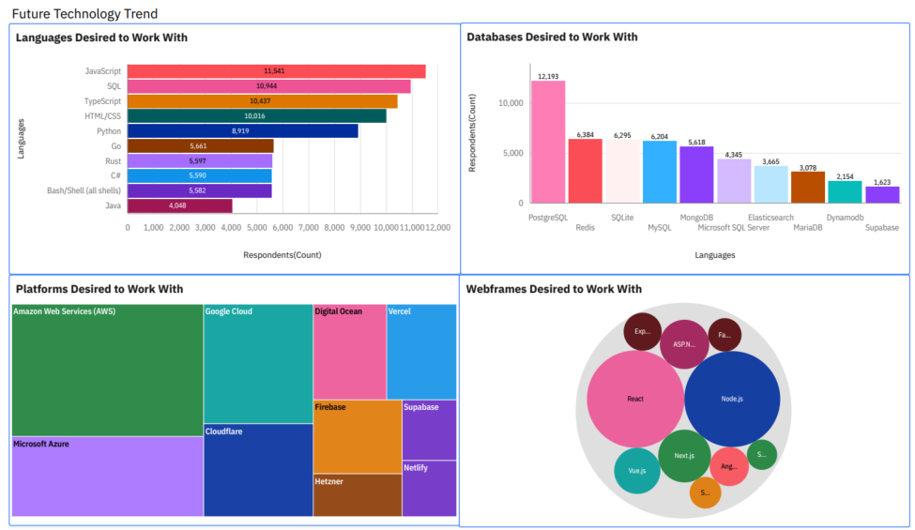
DASHBOARD TAB 2

Slide 13
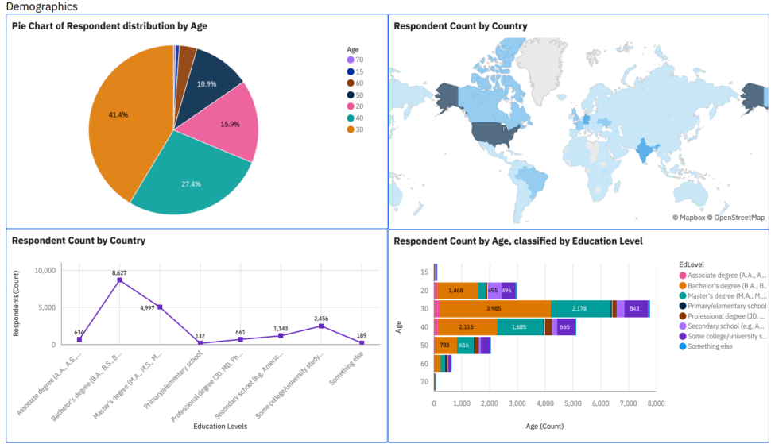
DASHBOARD TAB 3

Slide 14
DISCUSSION
Web development languages (Javascript and HTML/CSS) and SQL are the most commonly used technologies among job postings.
PostgreSQL remains the top database choice, reflecting its reliability and strong industry preference.
Redis is gaining momentum as many professionals are transitioning to it from other databases.
AWS continues to be the dominant cloud platform, both in usage and in demand.
Node.js and React lead among web frameworks, maintaining steady popularity across postings.

Slide 15
OVERALL FINDINGS & IMPLICATIONS
Findings
Web development languages continue to grow in demand
Open-source RDBMS dominates
Redis is the breakout star
Developed countries have higher numbers of respondents
Enterprise DBs (Oracle, MS SQL) stagnate
Implications
Continue to train workers on web development languages
The scalability of PostgreSQL makes it the top choice
Developing countries have limited numbers of developers

Slide 16

CONCLUSION
Investing in technology training is essential, especially in developing countries, to bridge skill gaps and foster innovation
Continuous upskilling in web development languages is vital to maintain relevance in a rapidly evolving tech landscape.
Developers are encouraged to prioritize in-demand technologies such as PostgreSQL, Redis, Go, and Rust to stay competitive.
The dominance of open-source RDBMS highlights the need to promote and support open-source tools in developer communities.

Slide 17
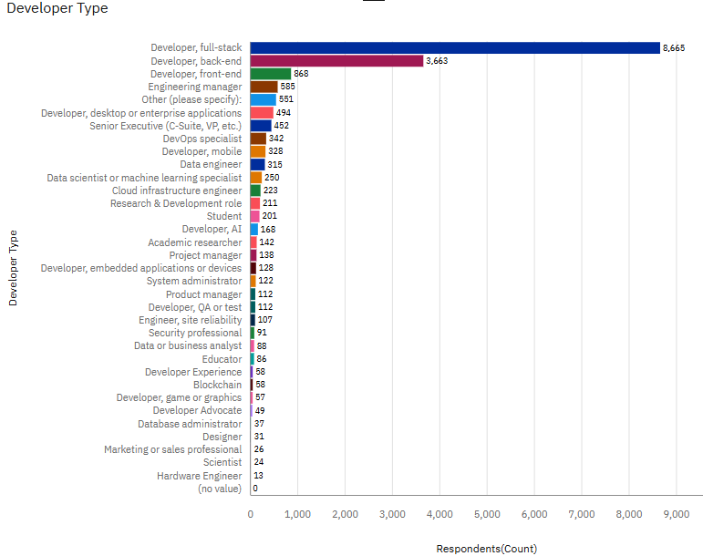

APPENDIX
Full Stack developers are highly sought after

Slide 18
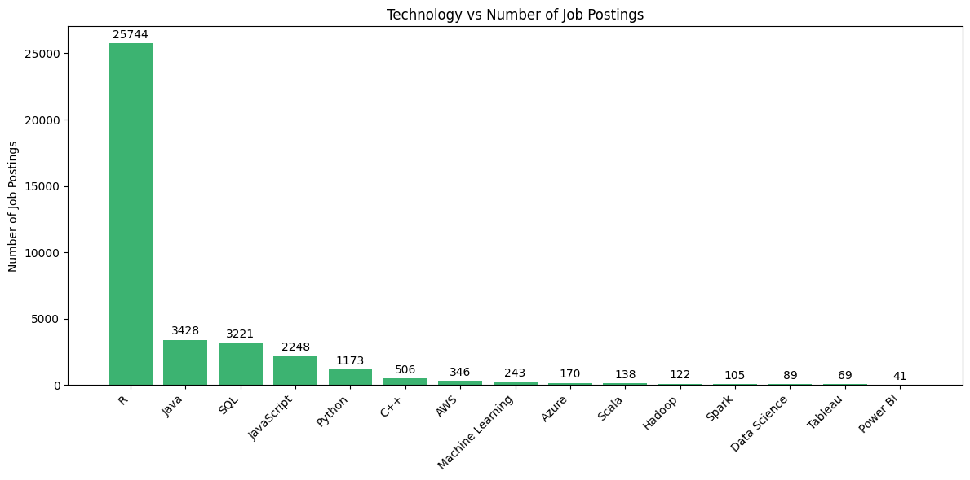
JOB POSTINGS
Job posting by Technology

Slide 19
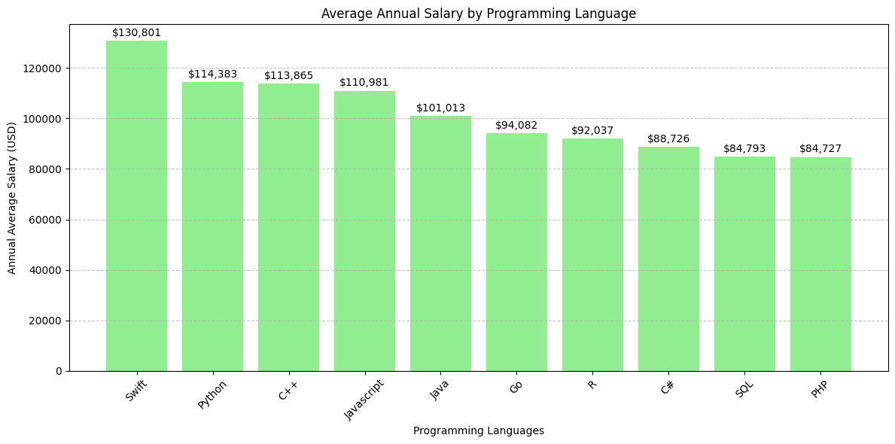
POPULAR LANGUAGES
Popular languages and their average annual salaries. Data extracted from GitHub using Web scraping python tool: Beautifulsoup.

